Slide 1
WEBSITE WITH FACE RECOGNITION
Presented by-
Hrishika Anjana
Ekta Pandey
Shivani Pandey

Slide 2
OUTLINES
SCOPE 6.
1. INTRODUCTION
BACK END & FACE RECOGNITION
2. OBJECTIVE
5.
FRONT END 4.
3. MODULES

Slide 3
CRIMINAL INVESTIGATION COMMAND
BASIC IDEA
INTRODUCTION
INVESTIGATION WEBSITE
PUBLIC GRIEVANCE
FACE RECOGNITION
CRIMINAL OFFENCE

Slide 4
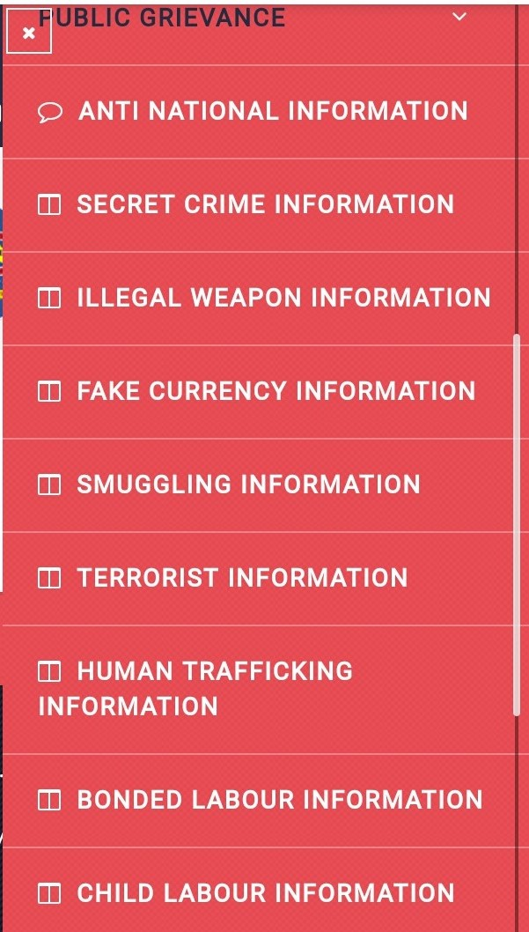
MODULES
USER
Feed information under public grievance
Illegal Weapon
Smuggling
Terrorist
Human trafficking
Others
2. ADMIN
Right to access information by user.
Feed criminal records in database
Assign members
3. AUTHORIZED MEMBERS
Recognize criminal faces

Slide 5
OBJECTIVE
Monitor suspicious activity
Provide assistance and support
Recognize criminals
National security agenda
Gather Information

Slide 6
LOGIN
Admin login
Authorized login
Contact us
Phone number
Helpline
E-mail address
Address
PUBLIC GRIEVANCE
Illegal Weapon
Smuggling
Terror attack
Human Trafficking
Corruption
HOME
Criminal Investigation Command(CIC)
About us
Past Success Records
FRONT
END

Slide 7
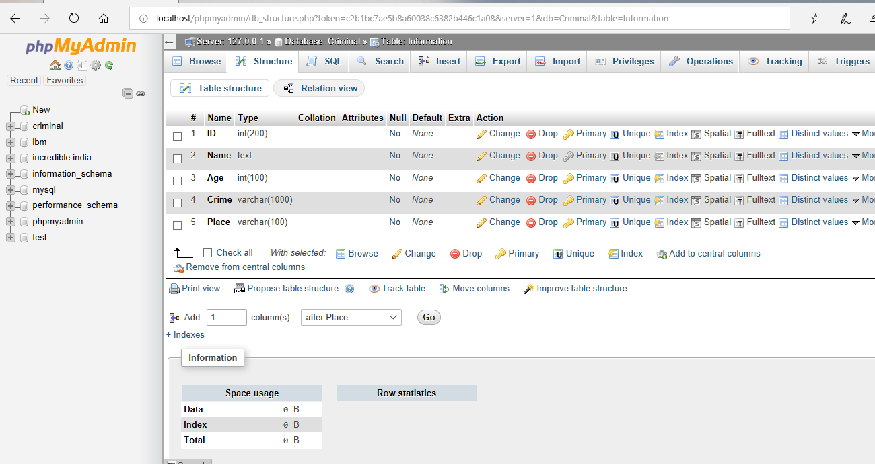
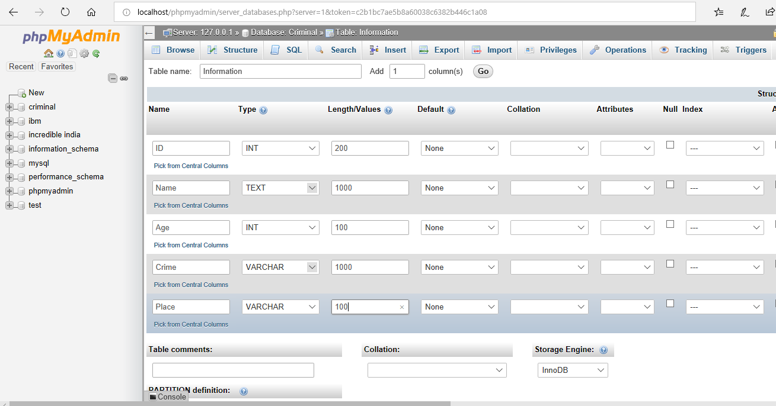
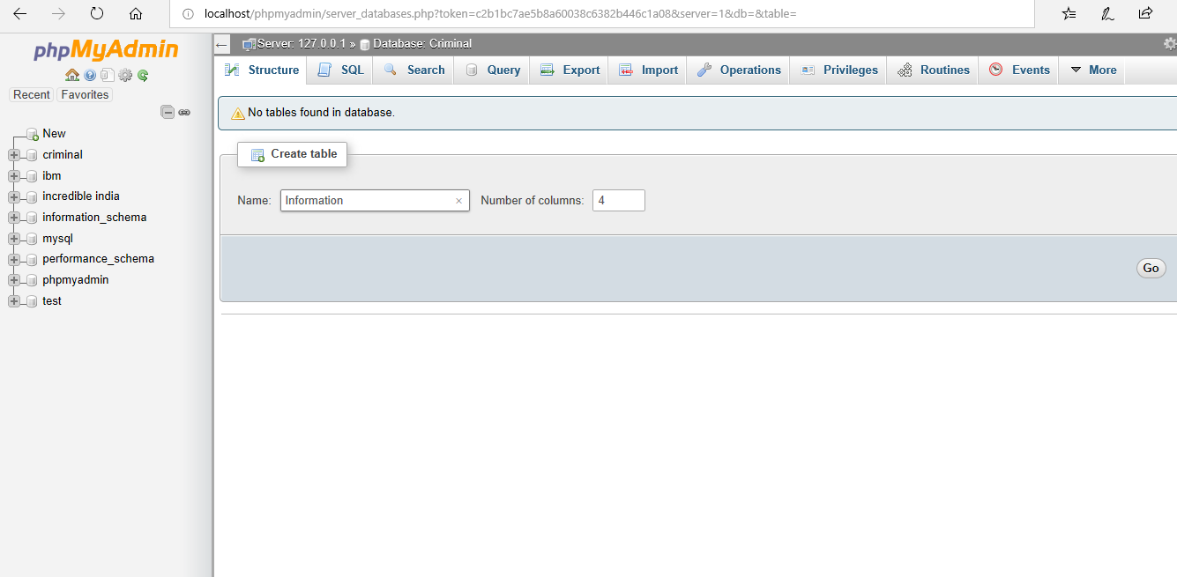

Slide 8
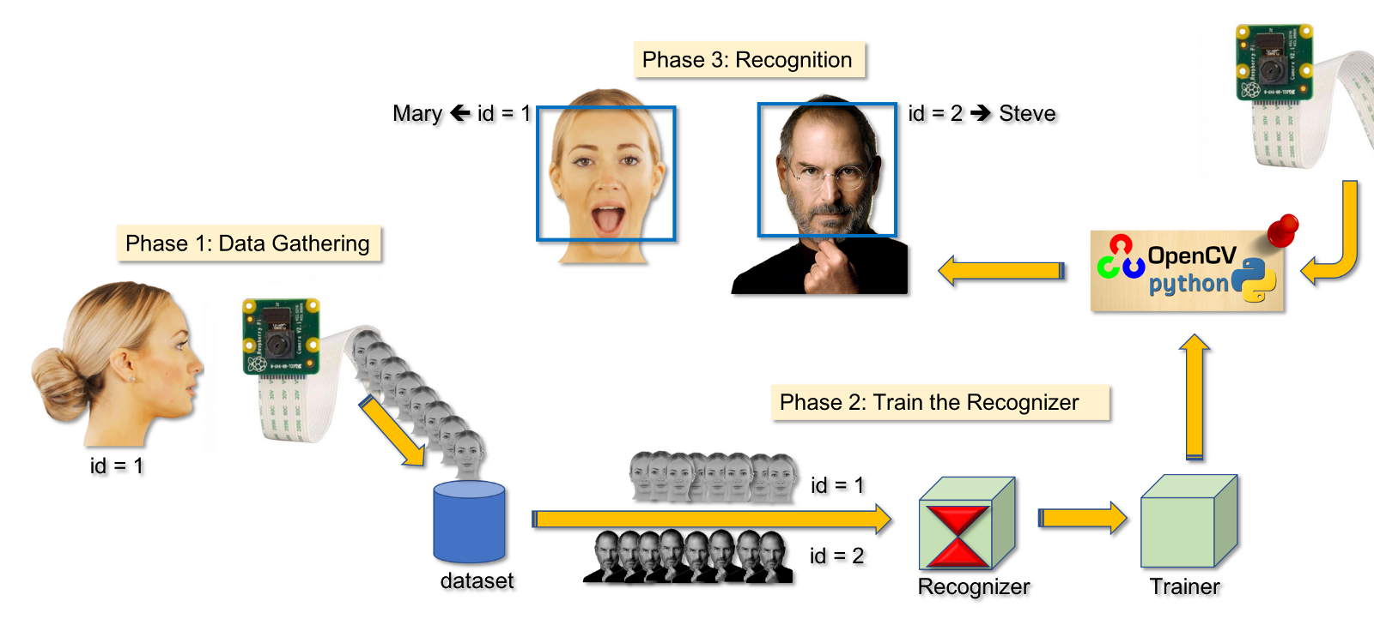

Slide 9
SYSTEM SPECIFICATION
Hardware
Pentium IV (dual core processor operating at 3.6 GHz) or above
200MB hard disk or above.
512 MB RAM or above.
Software
OpenCV 3.2.0
Operation System-Windows XP or above
XAMPP
Sublime Text 3

Slide 10
DATA FLOW DIAGRAMS

Slide 11
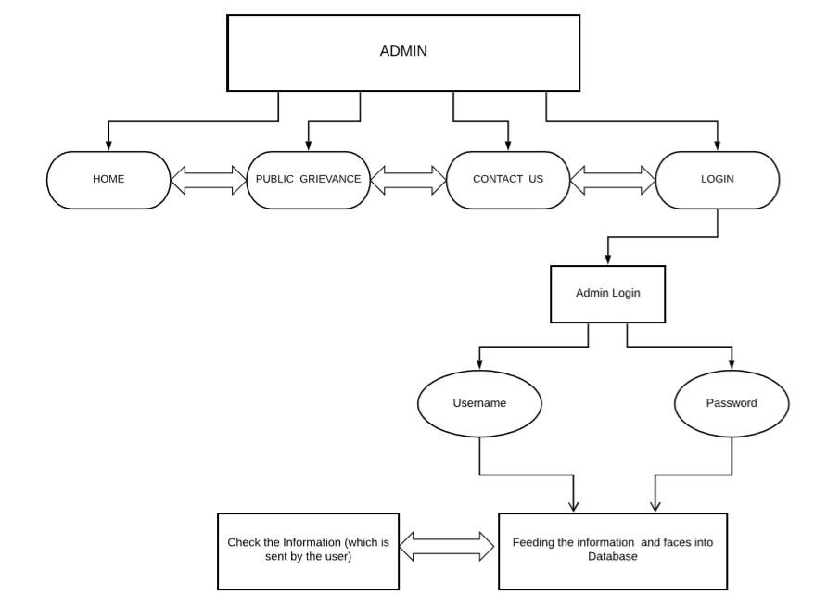

Slide 12
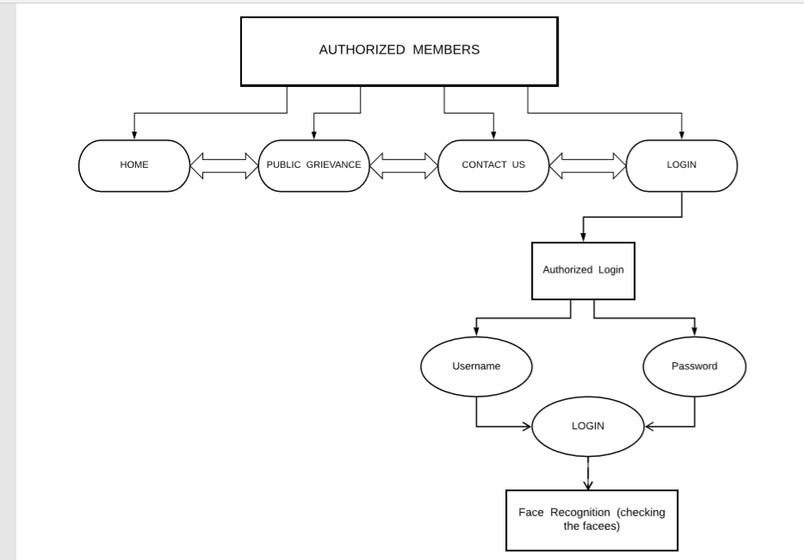

Slide 13
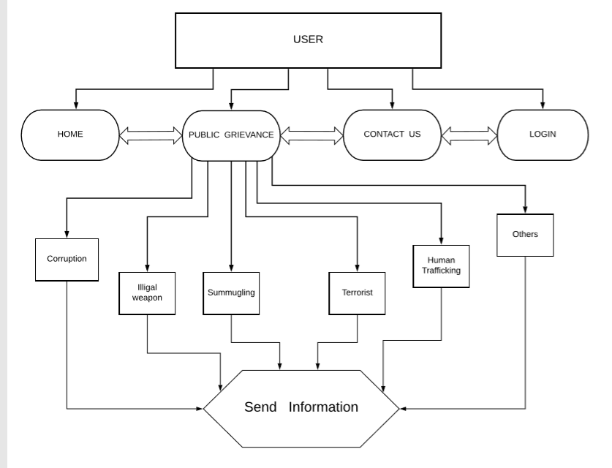

Slide 14
USE CASE DIAGRAM

Slide 15
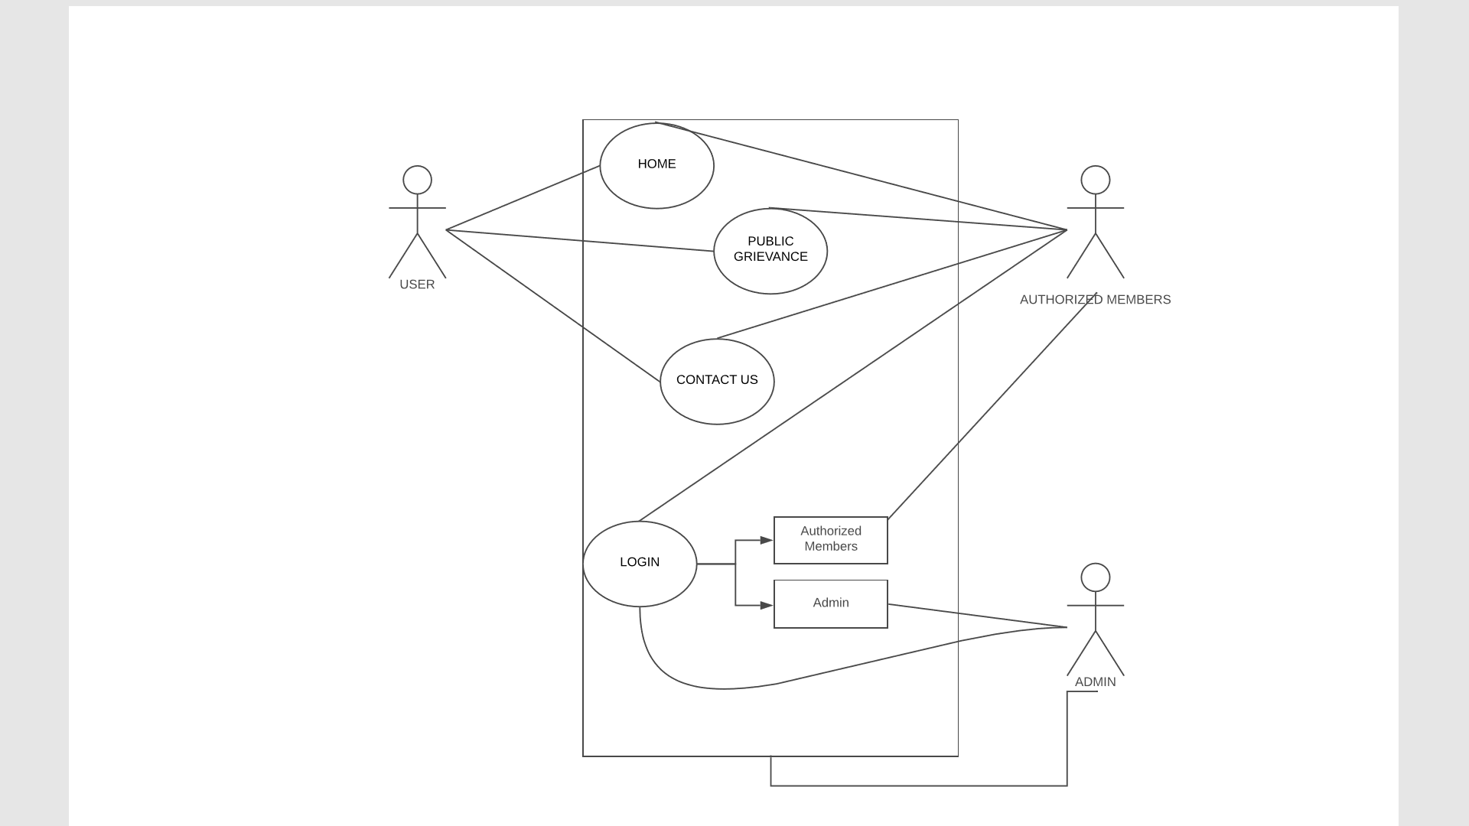

Slide 16
SCOPE:-
Conducting National Entrance Examinations:- It can be used as
student ID.
Airport Security checks:-To check the fake passport cases.
Social Media.
Preventing crime in retail.
Identify Missing people.

Slide 17
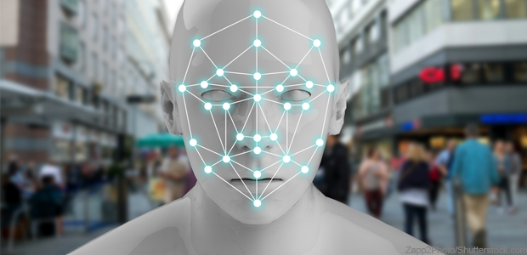
Conclusion
A facial recognition system uses biometrics to map facial features from photograph or video.
It compares the information with a database of known faces to find a match.
CCTV cameras will soon be outfitted with facial recognition technology that can automatically identify and track individual’s face in public.

Slide 18
REVIEW 2
OUTLINES
OVERVIEW
FRONT END
BACK END
CLASS DIAGRAM
SEQUENCE DIAGRAM
FLOWCHART

Slide 19
OVERVIEW
Connectivity 6.
1. Create web pages using HTML
MYSQL database
2. Styling using CSS
5.
PHP is used for back end 4.
3. Javascript is used.

Slide 20
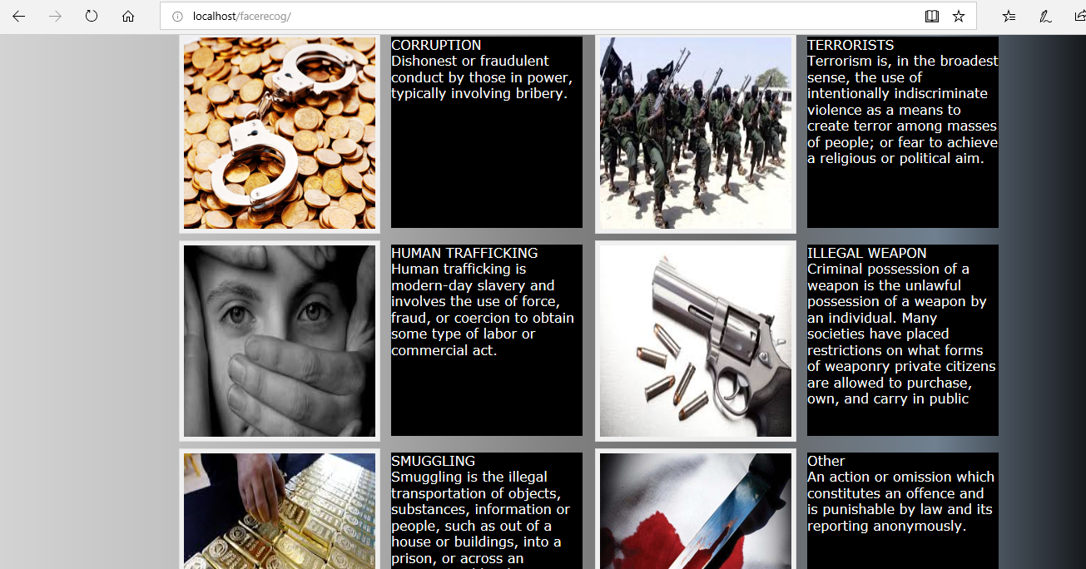
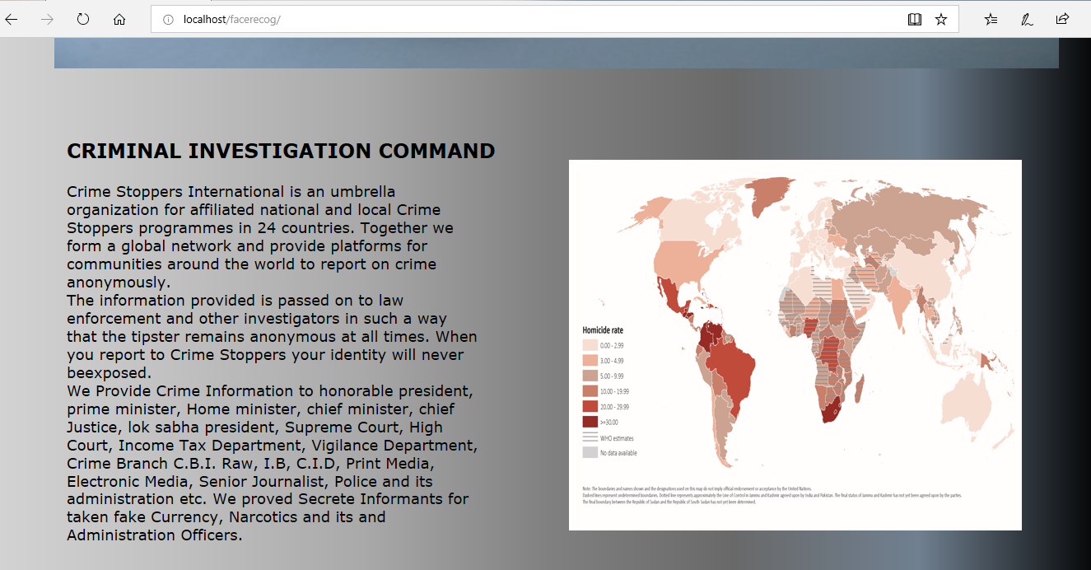
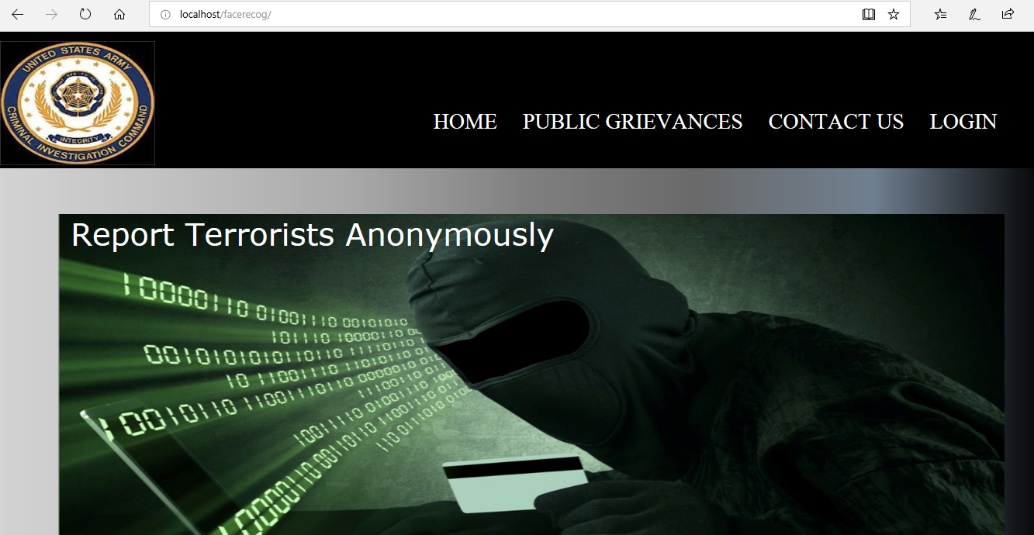
HOME PAGE

Slide 21
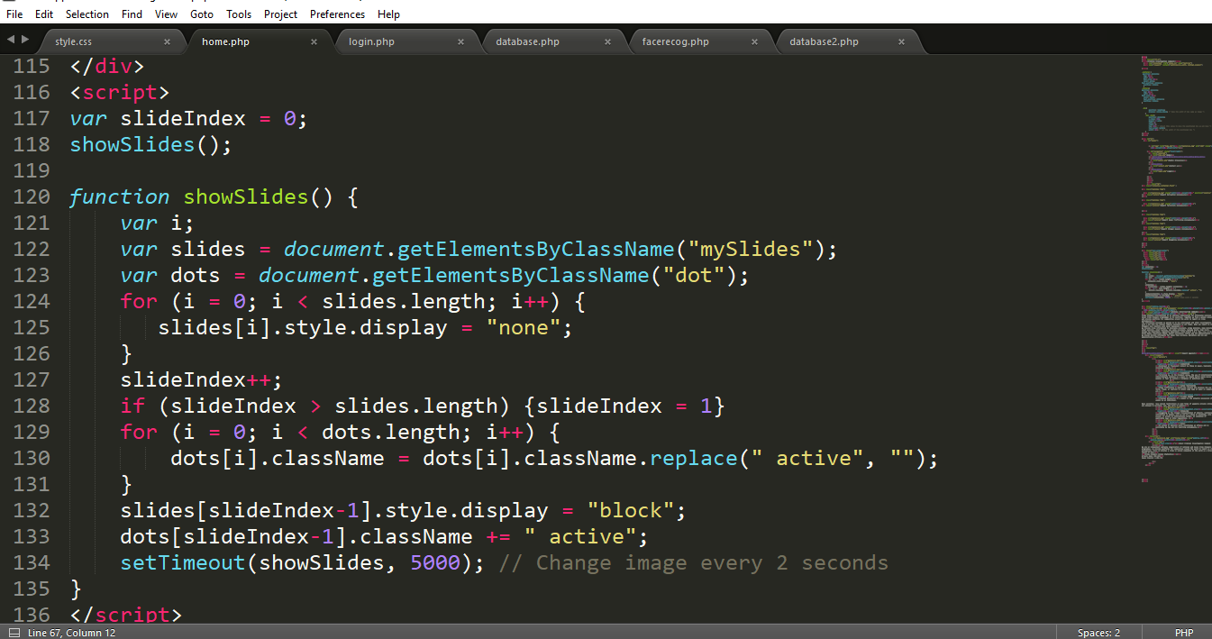
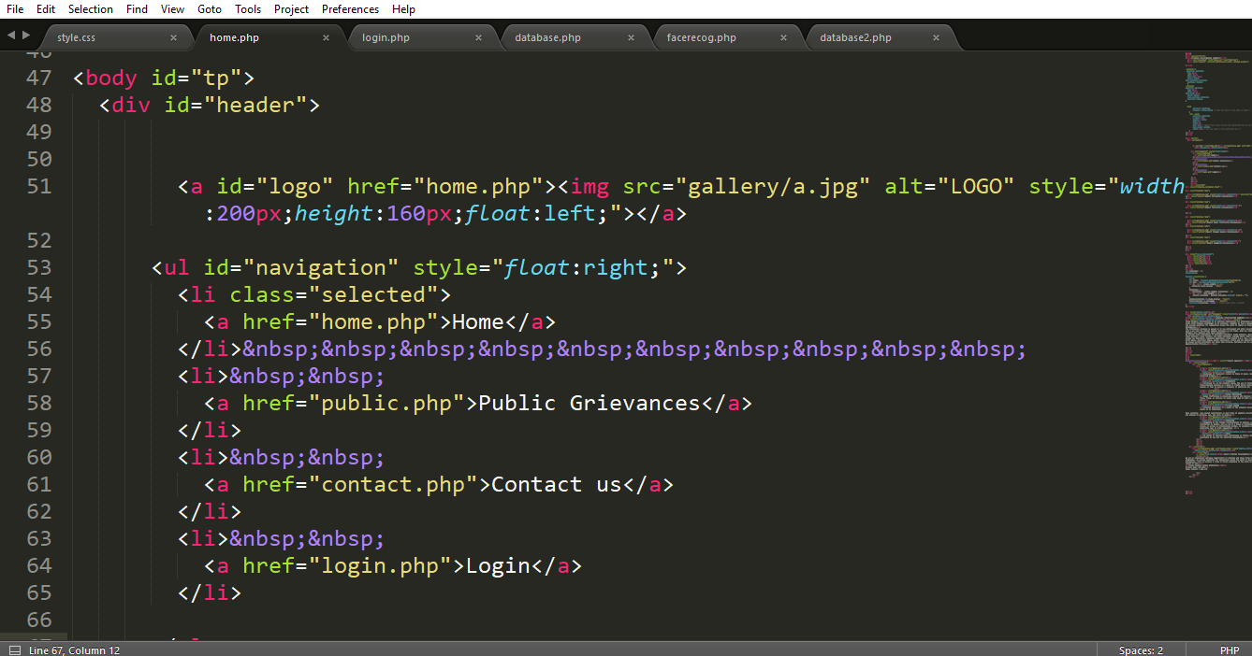
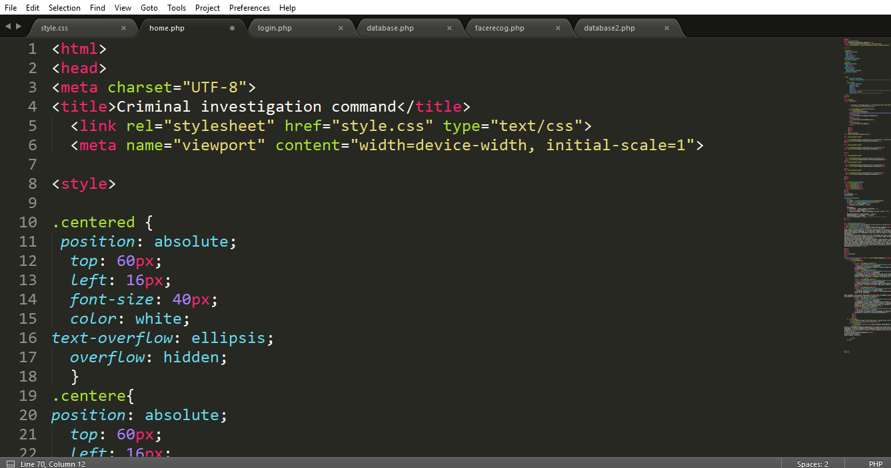

Slide 22
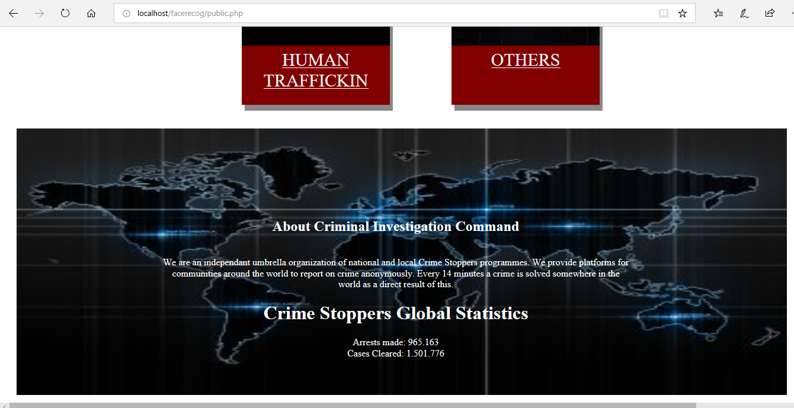
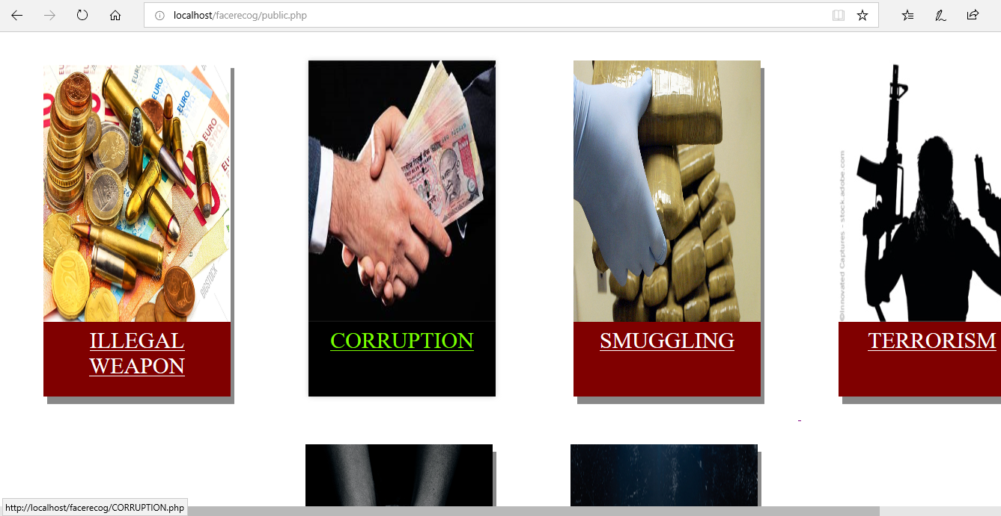
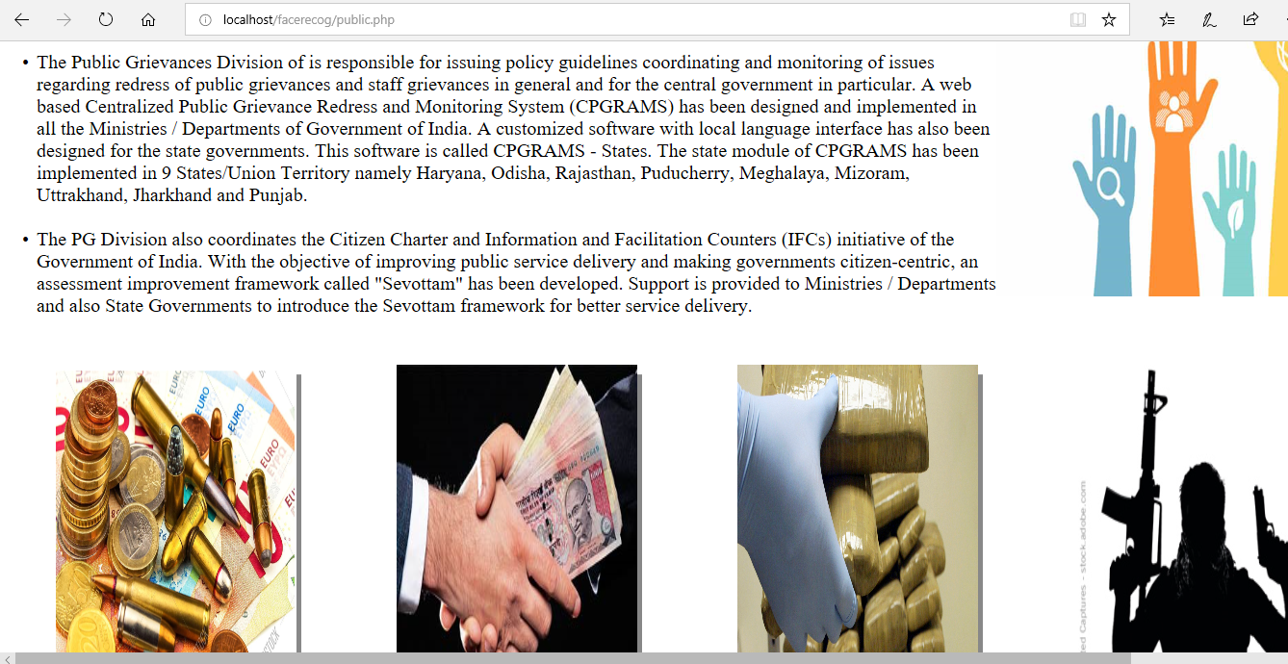
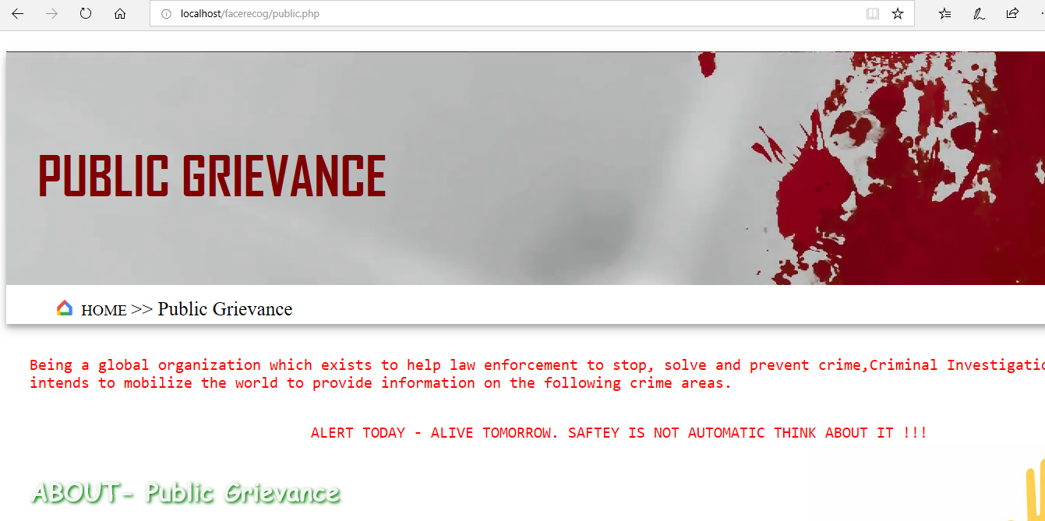
PUBLIC GRIEVANCES PAGE

Slide 23
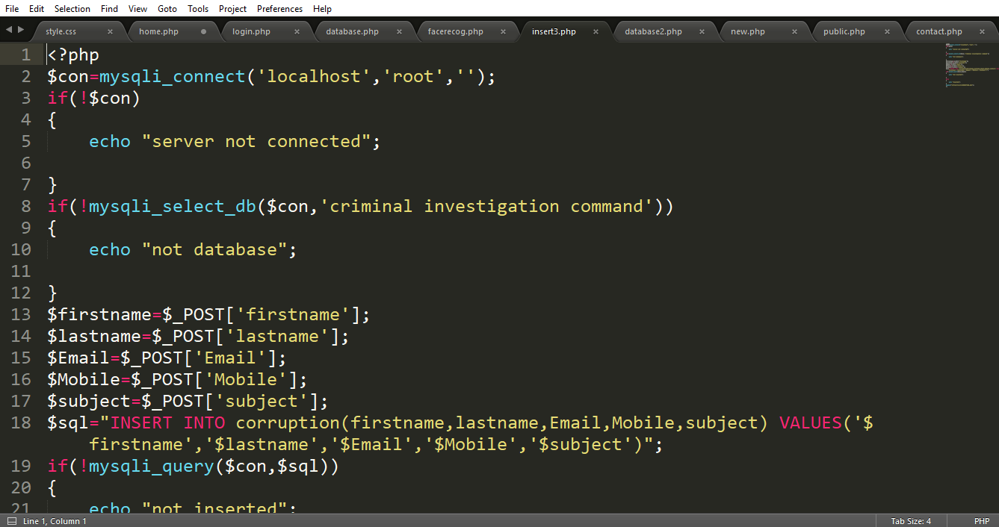
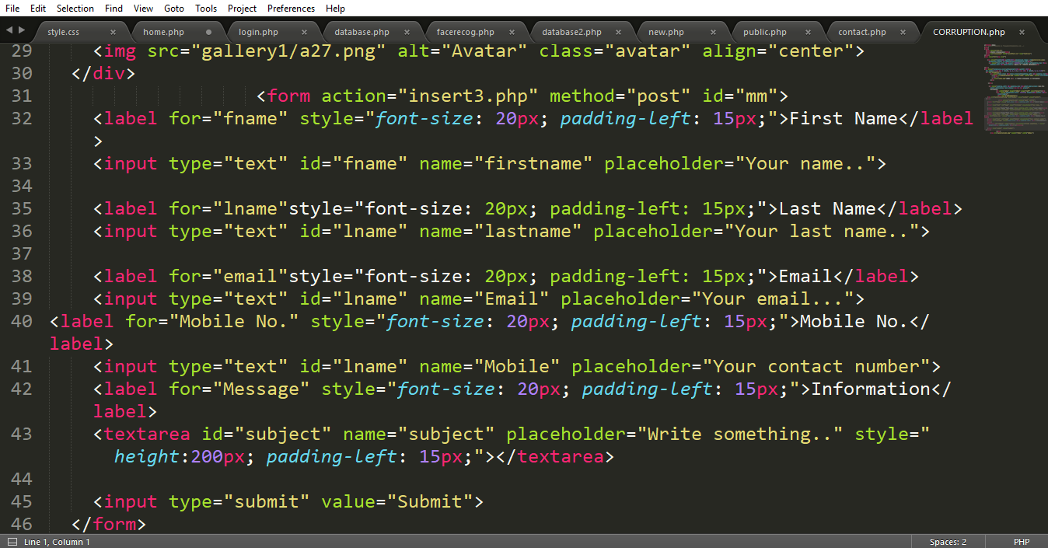
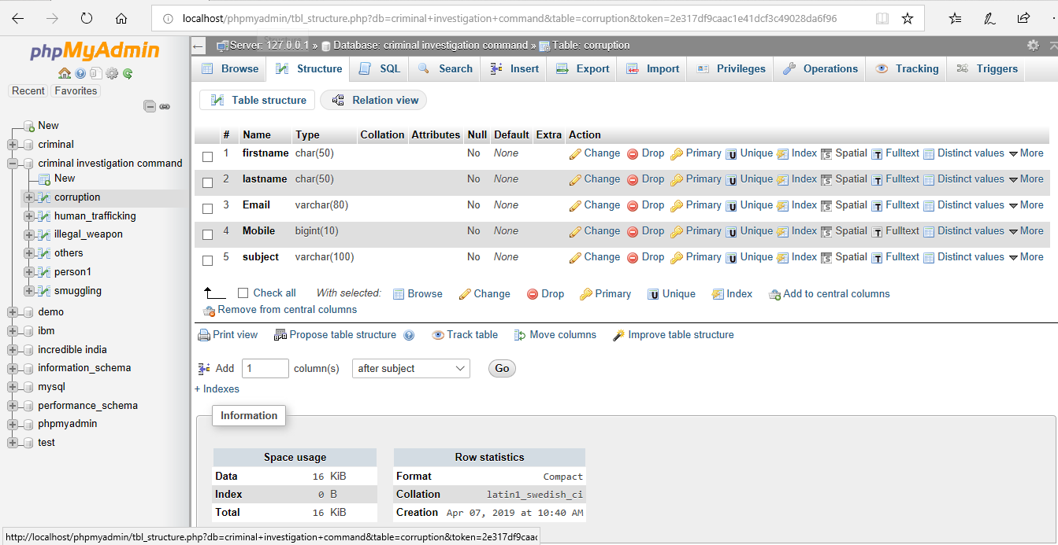

Slide 24
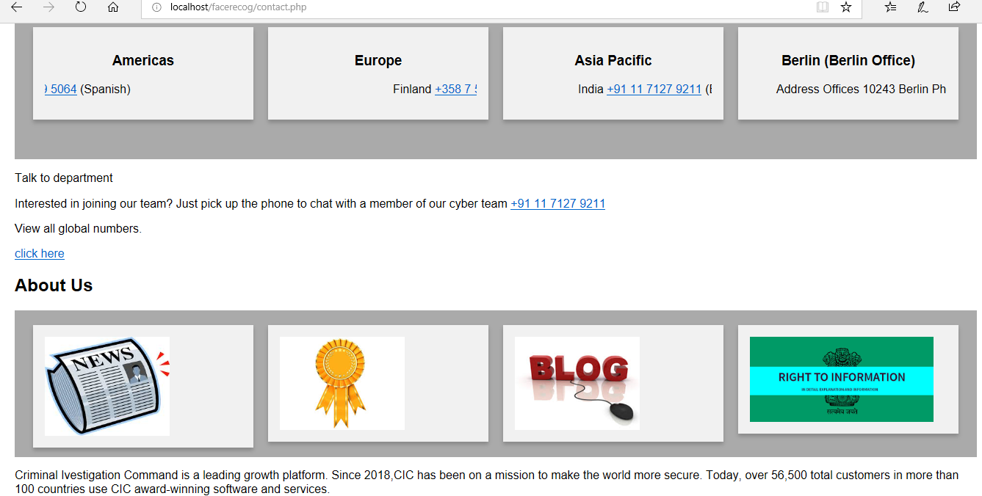
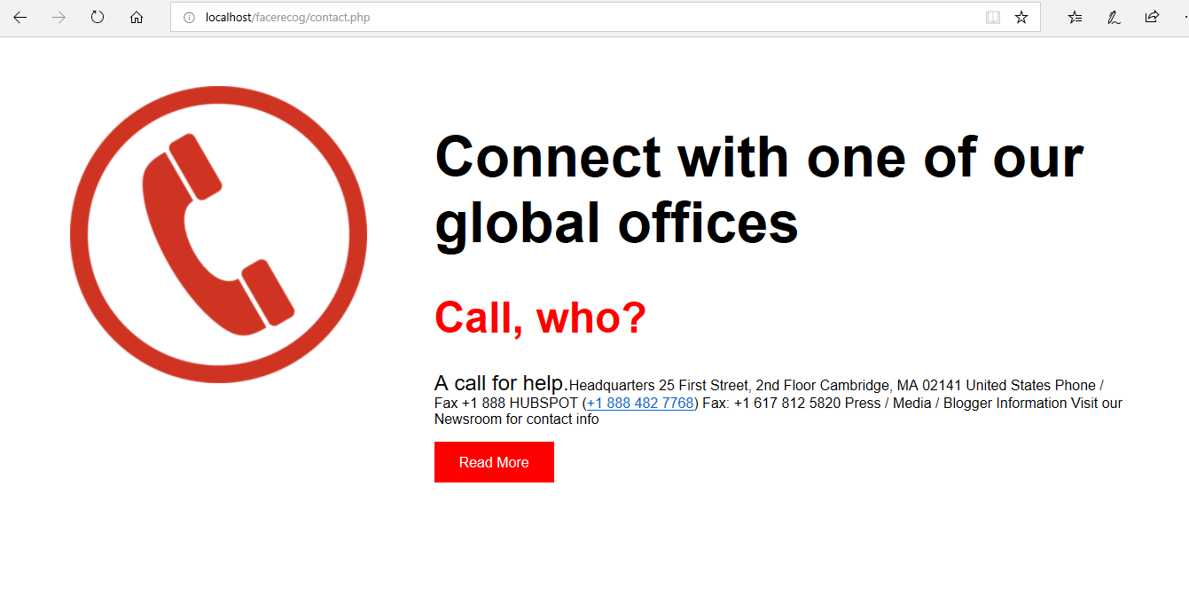
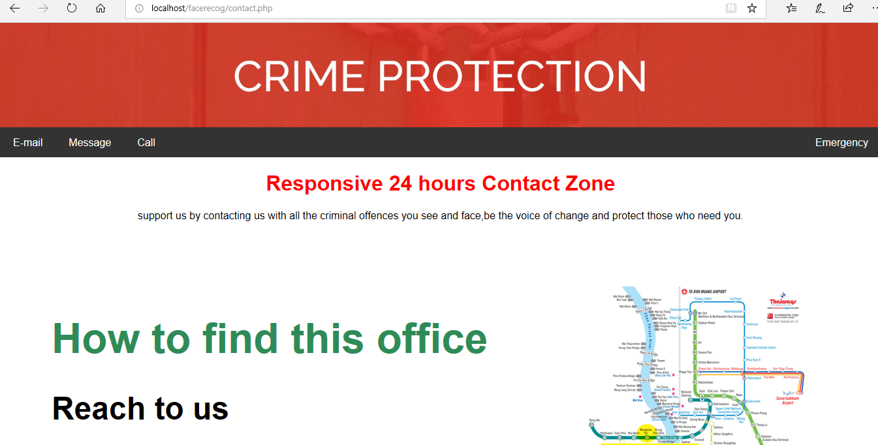
CONTACT US PAGE

Slide 25
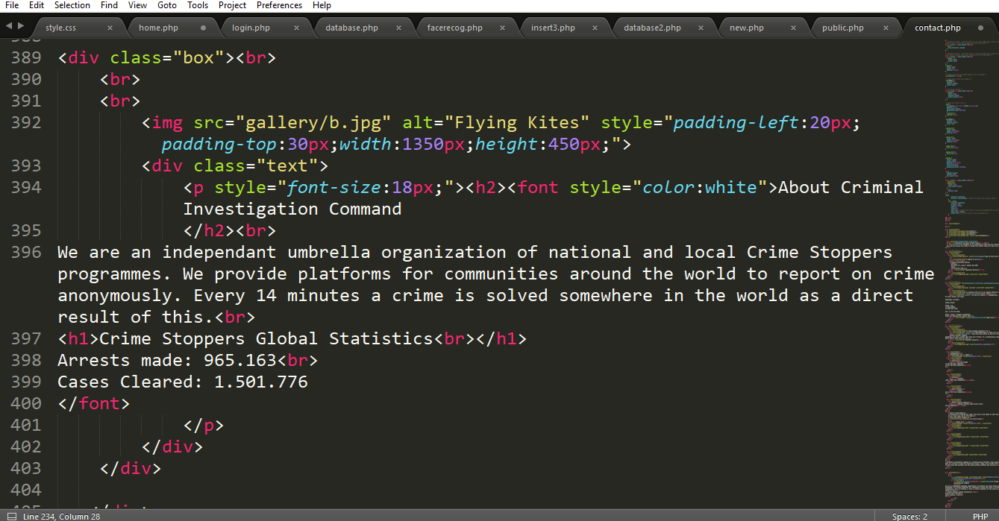
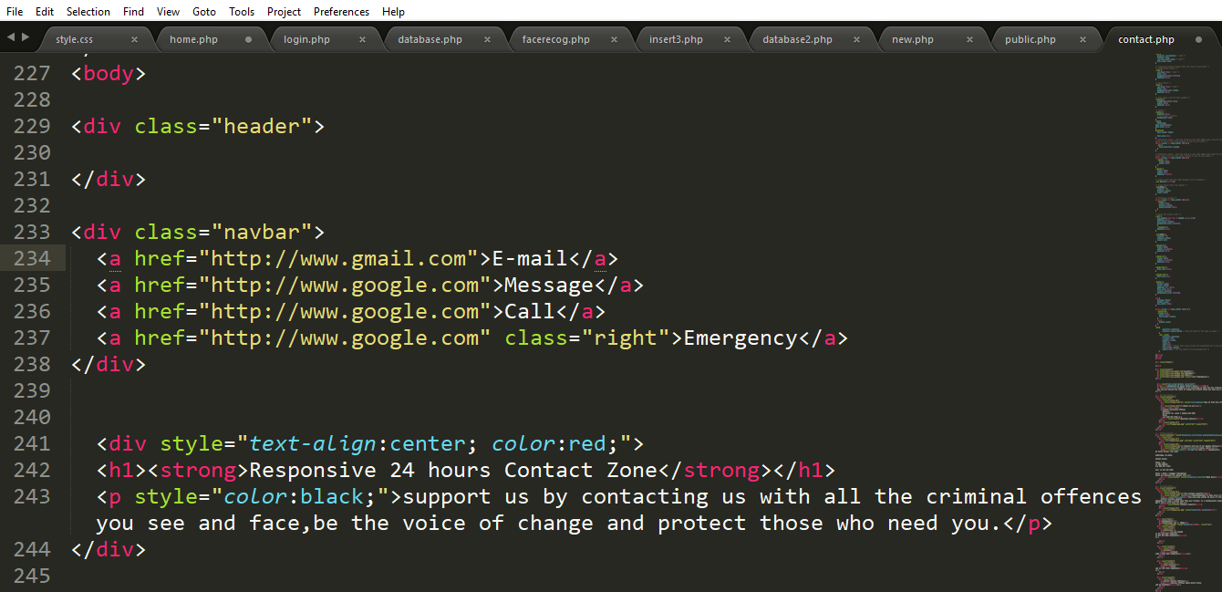

Slide 26
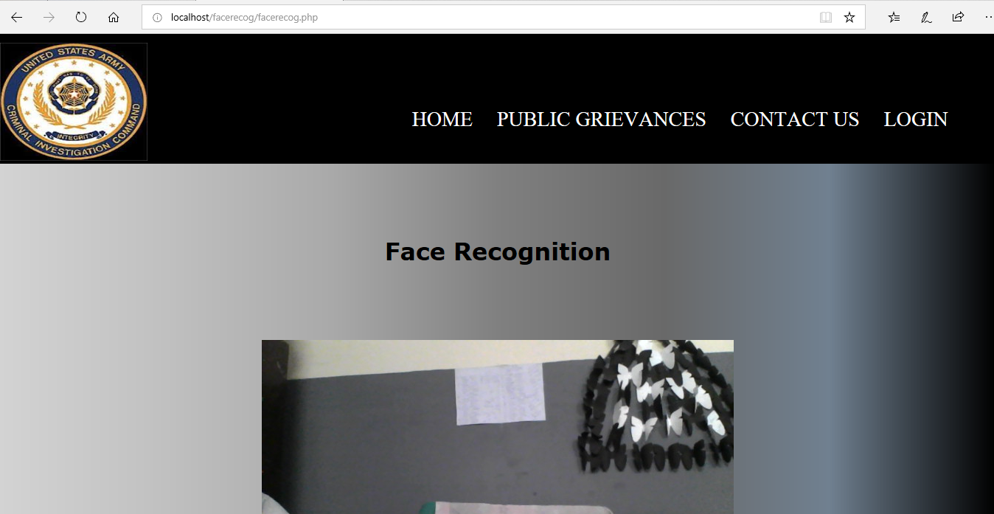
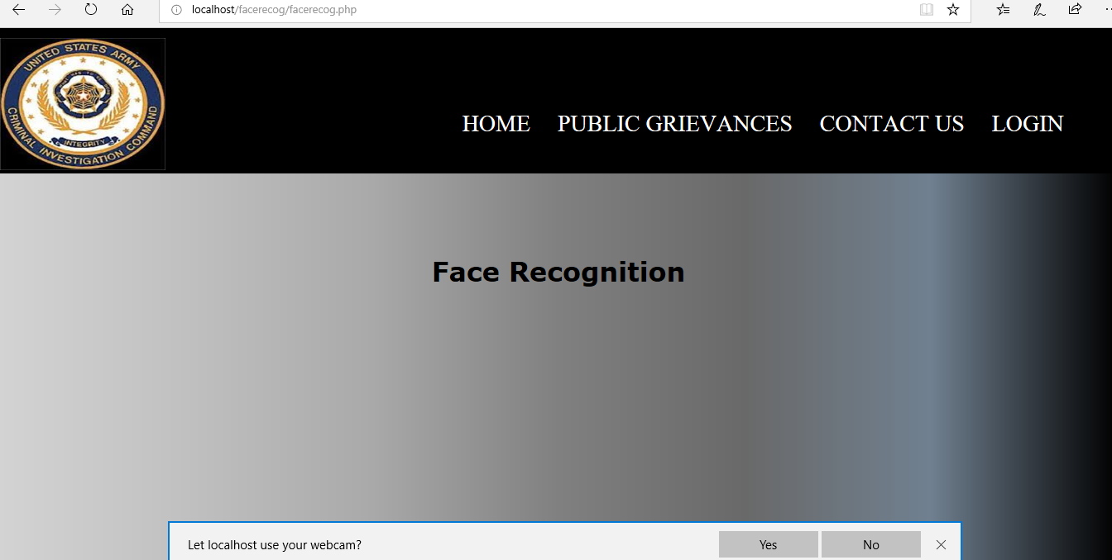
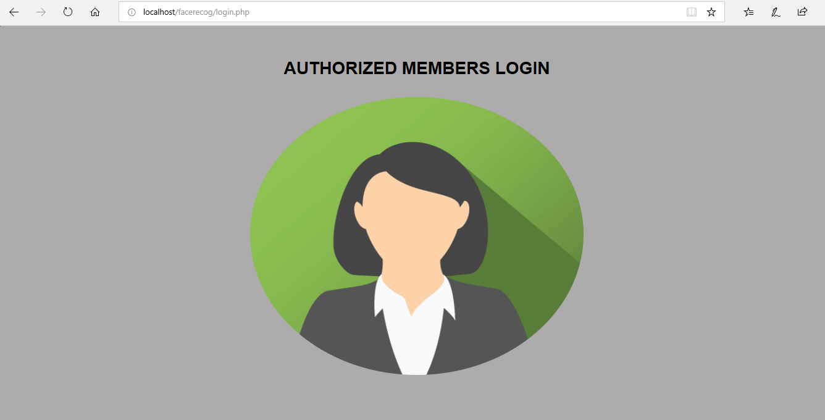
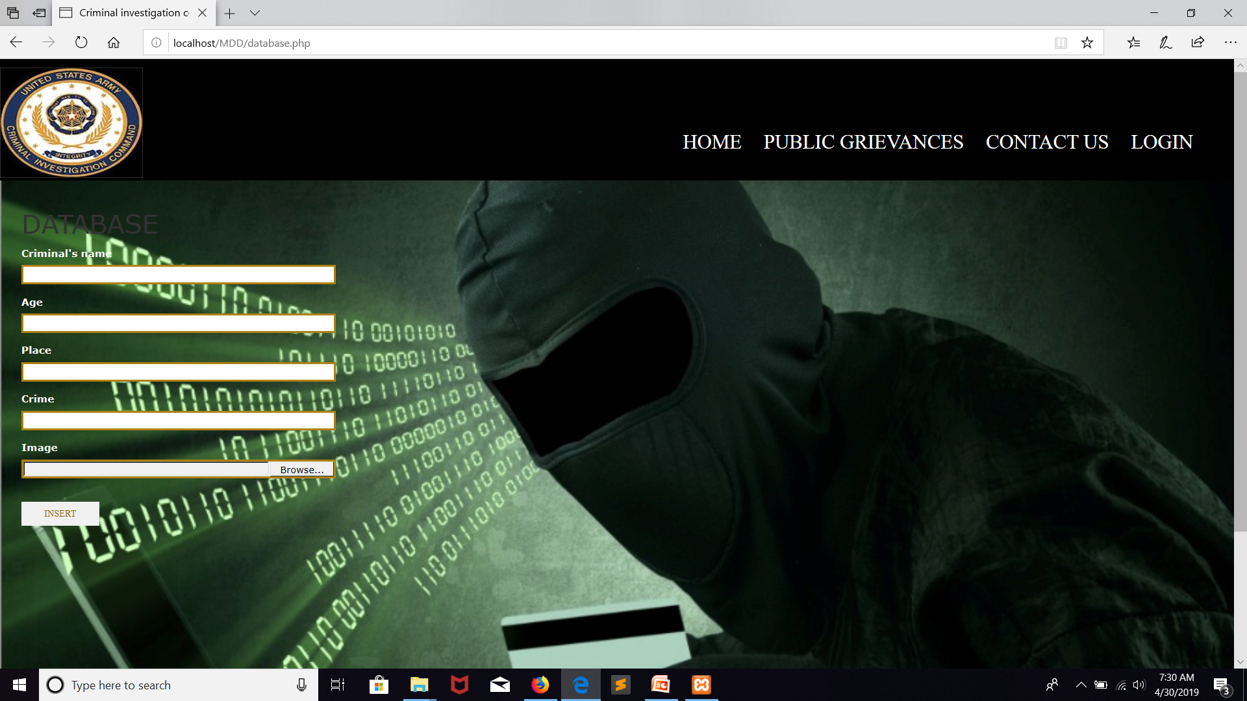
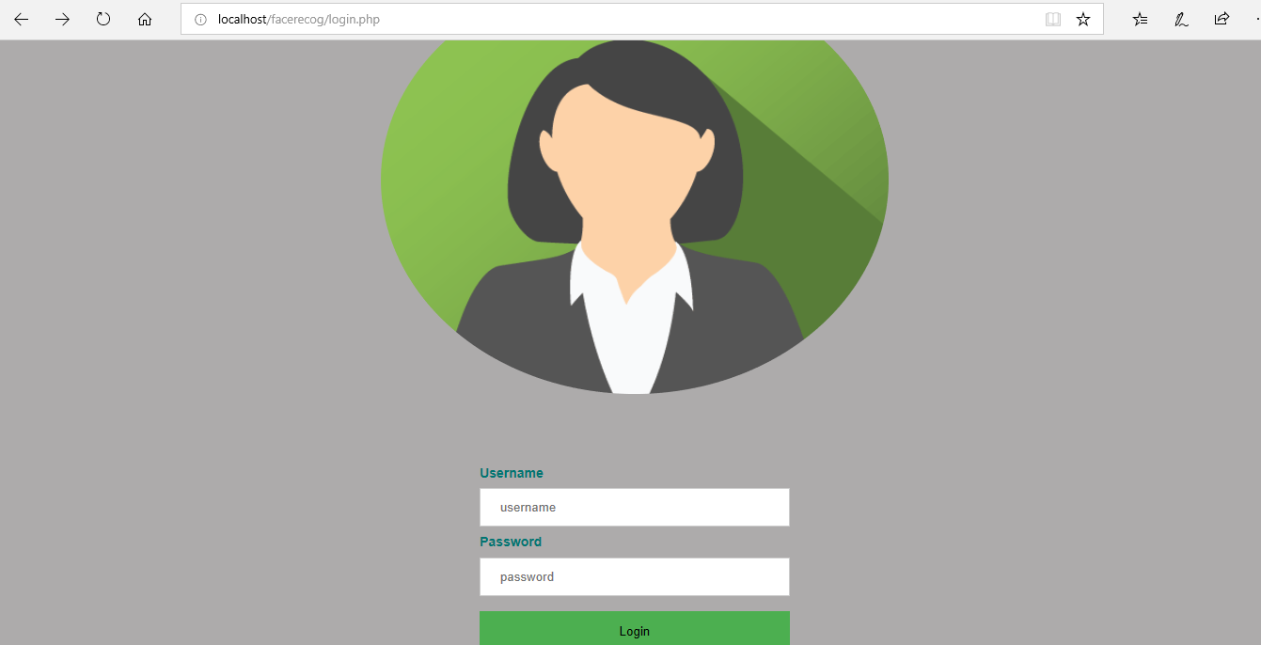
LOGIN PAGE

Slide 27
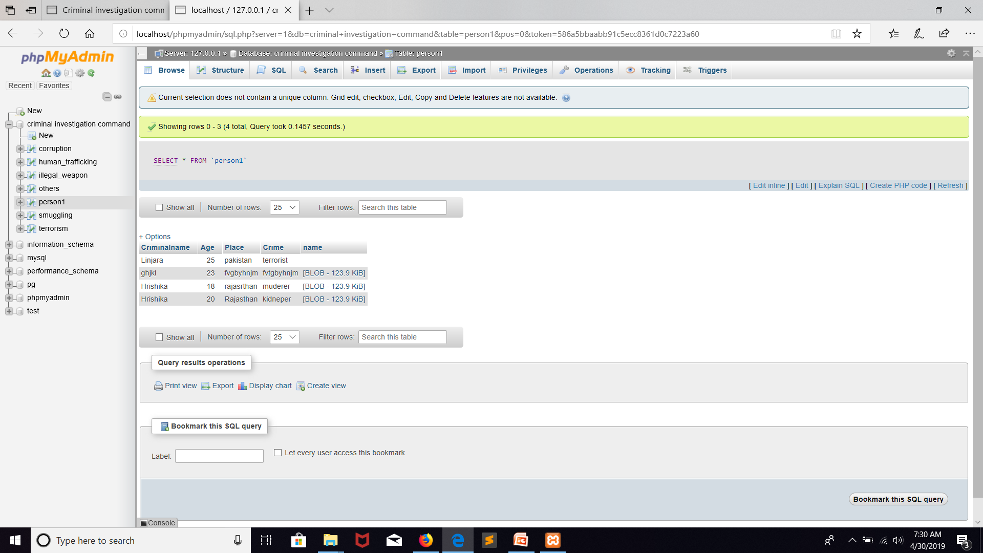
LOGIN DATABASE

Slide 28
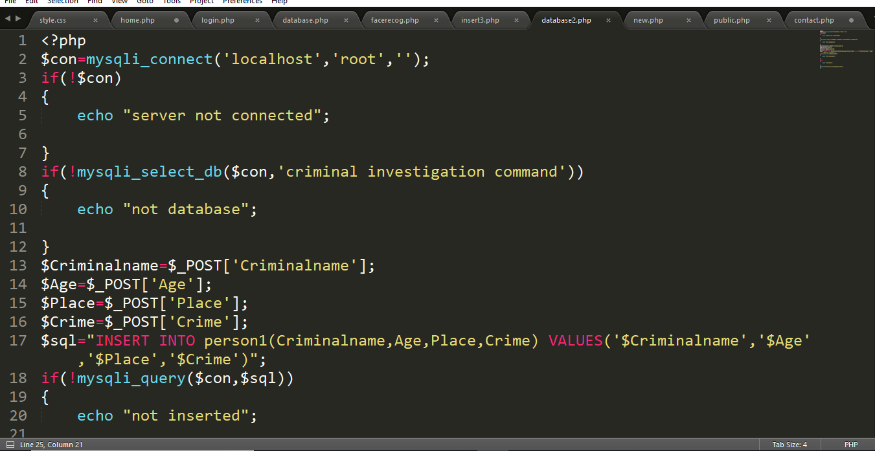
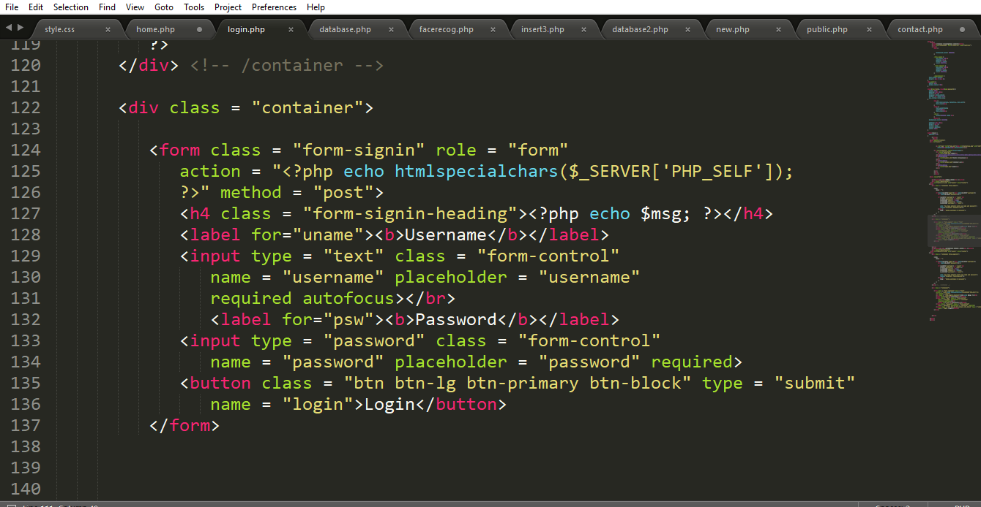
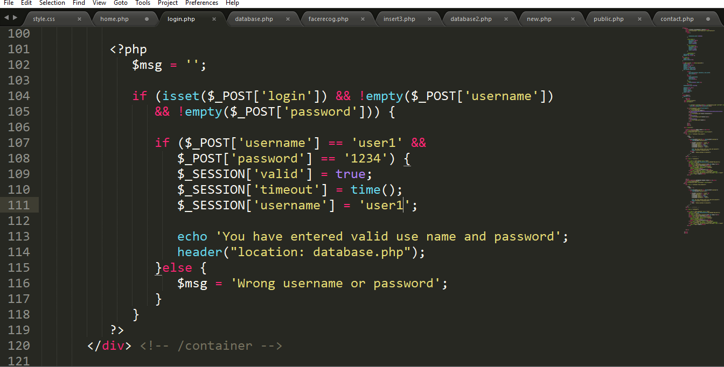

Slide 29
CLASS DIAGRAM

Slide 30
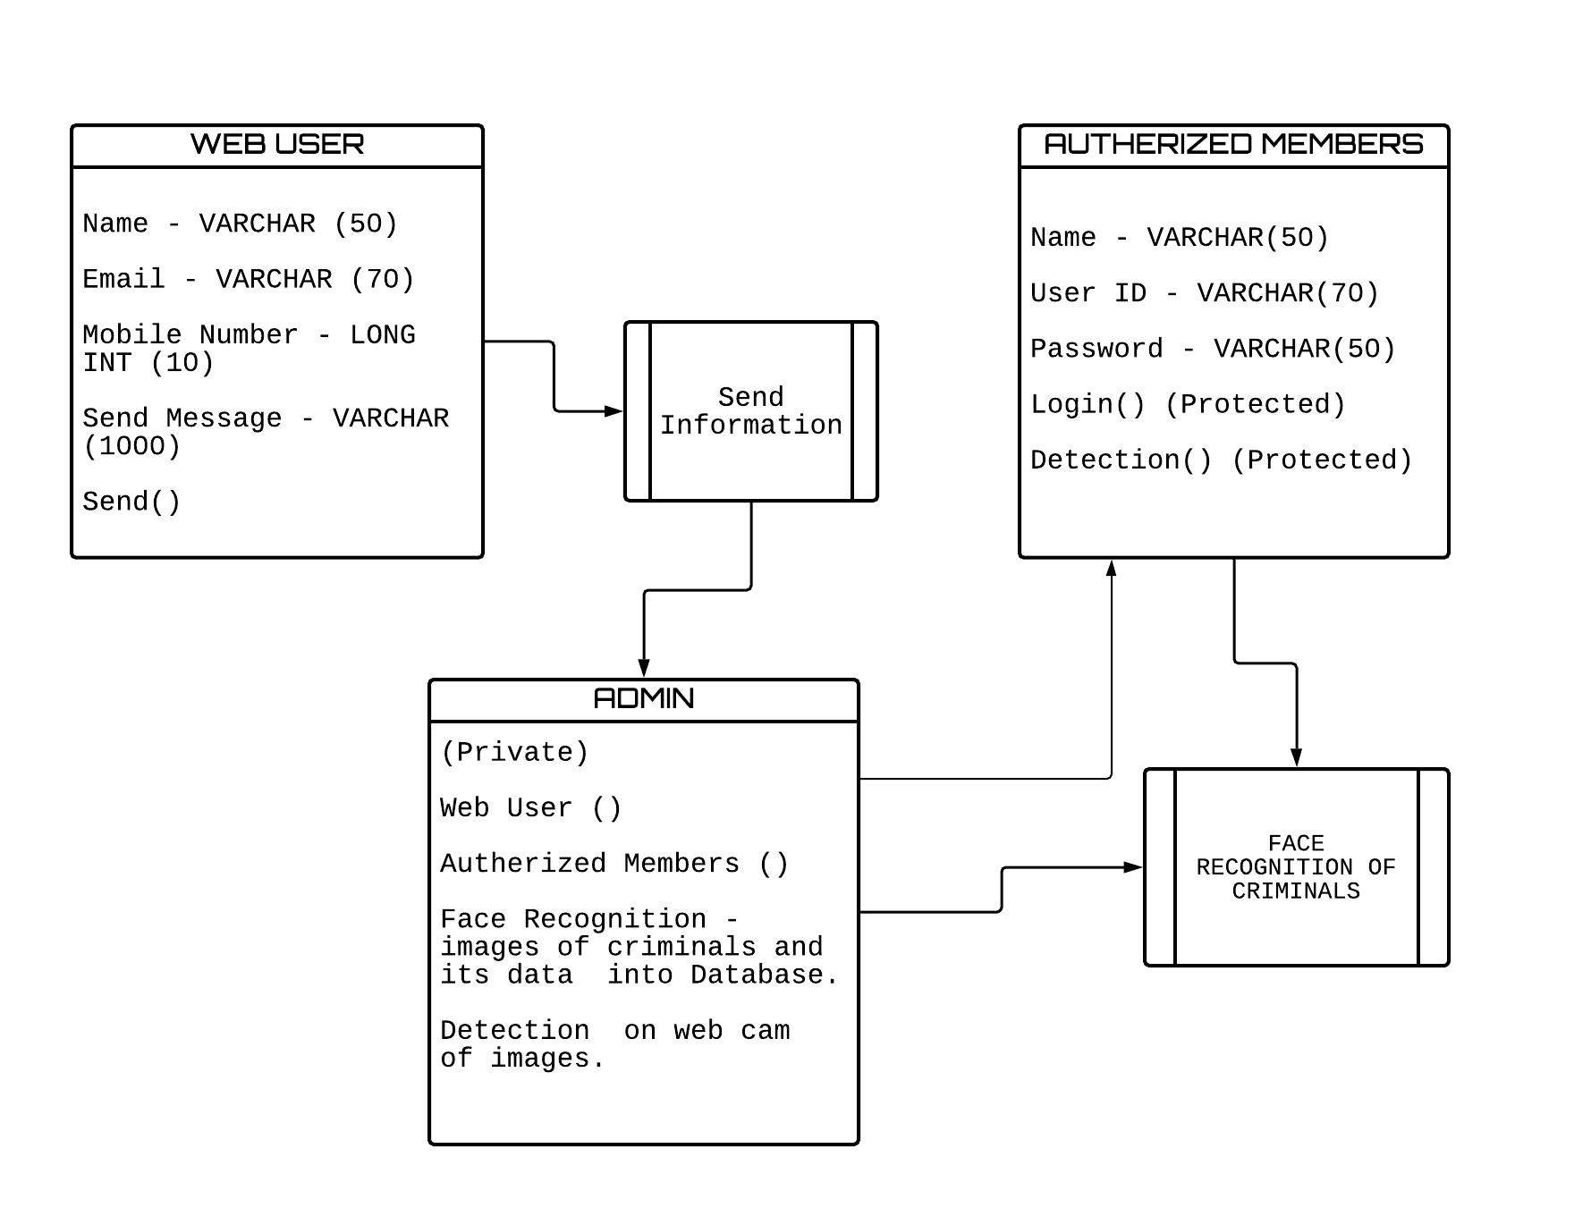

Slide 31
FLOWCHART

Slide 32
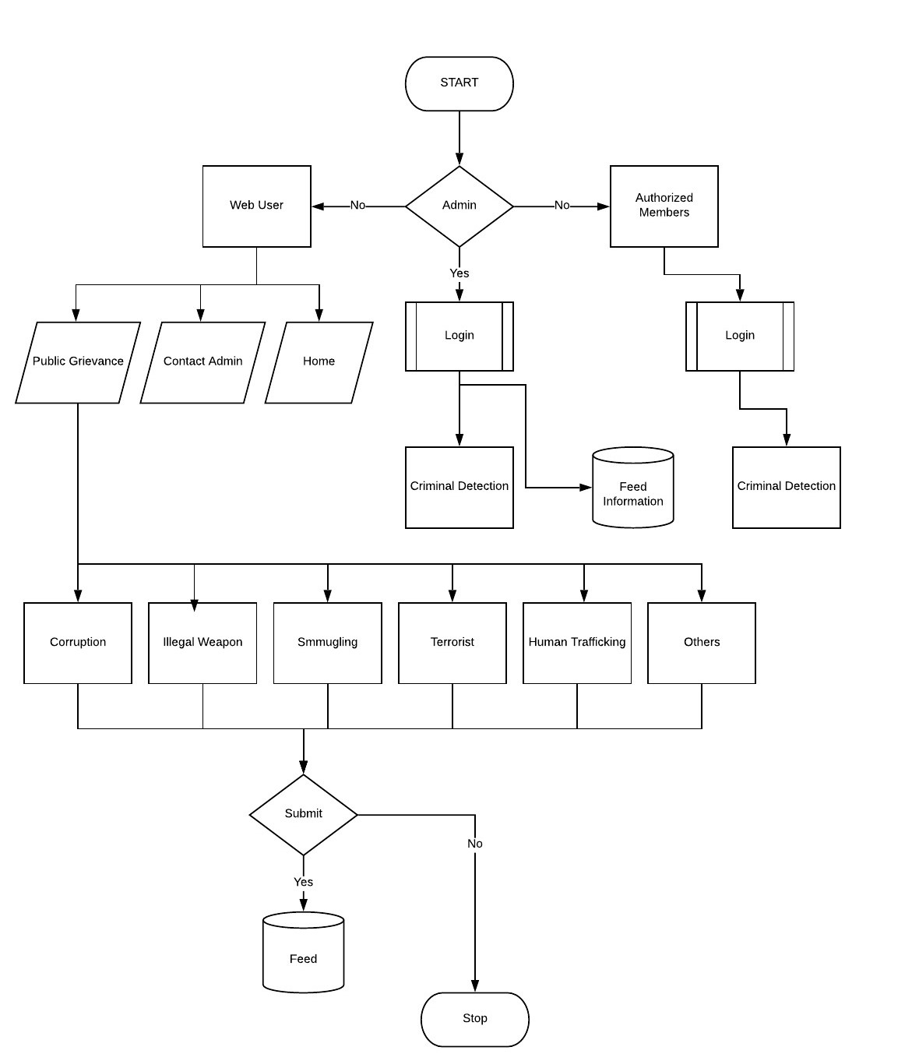

Slide 33
SEQUENCE DIAGRAM
1.USER
2.AUTHORIZED MEMBER

Slide 34
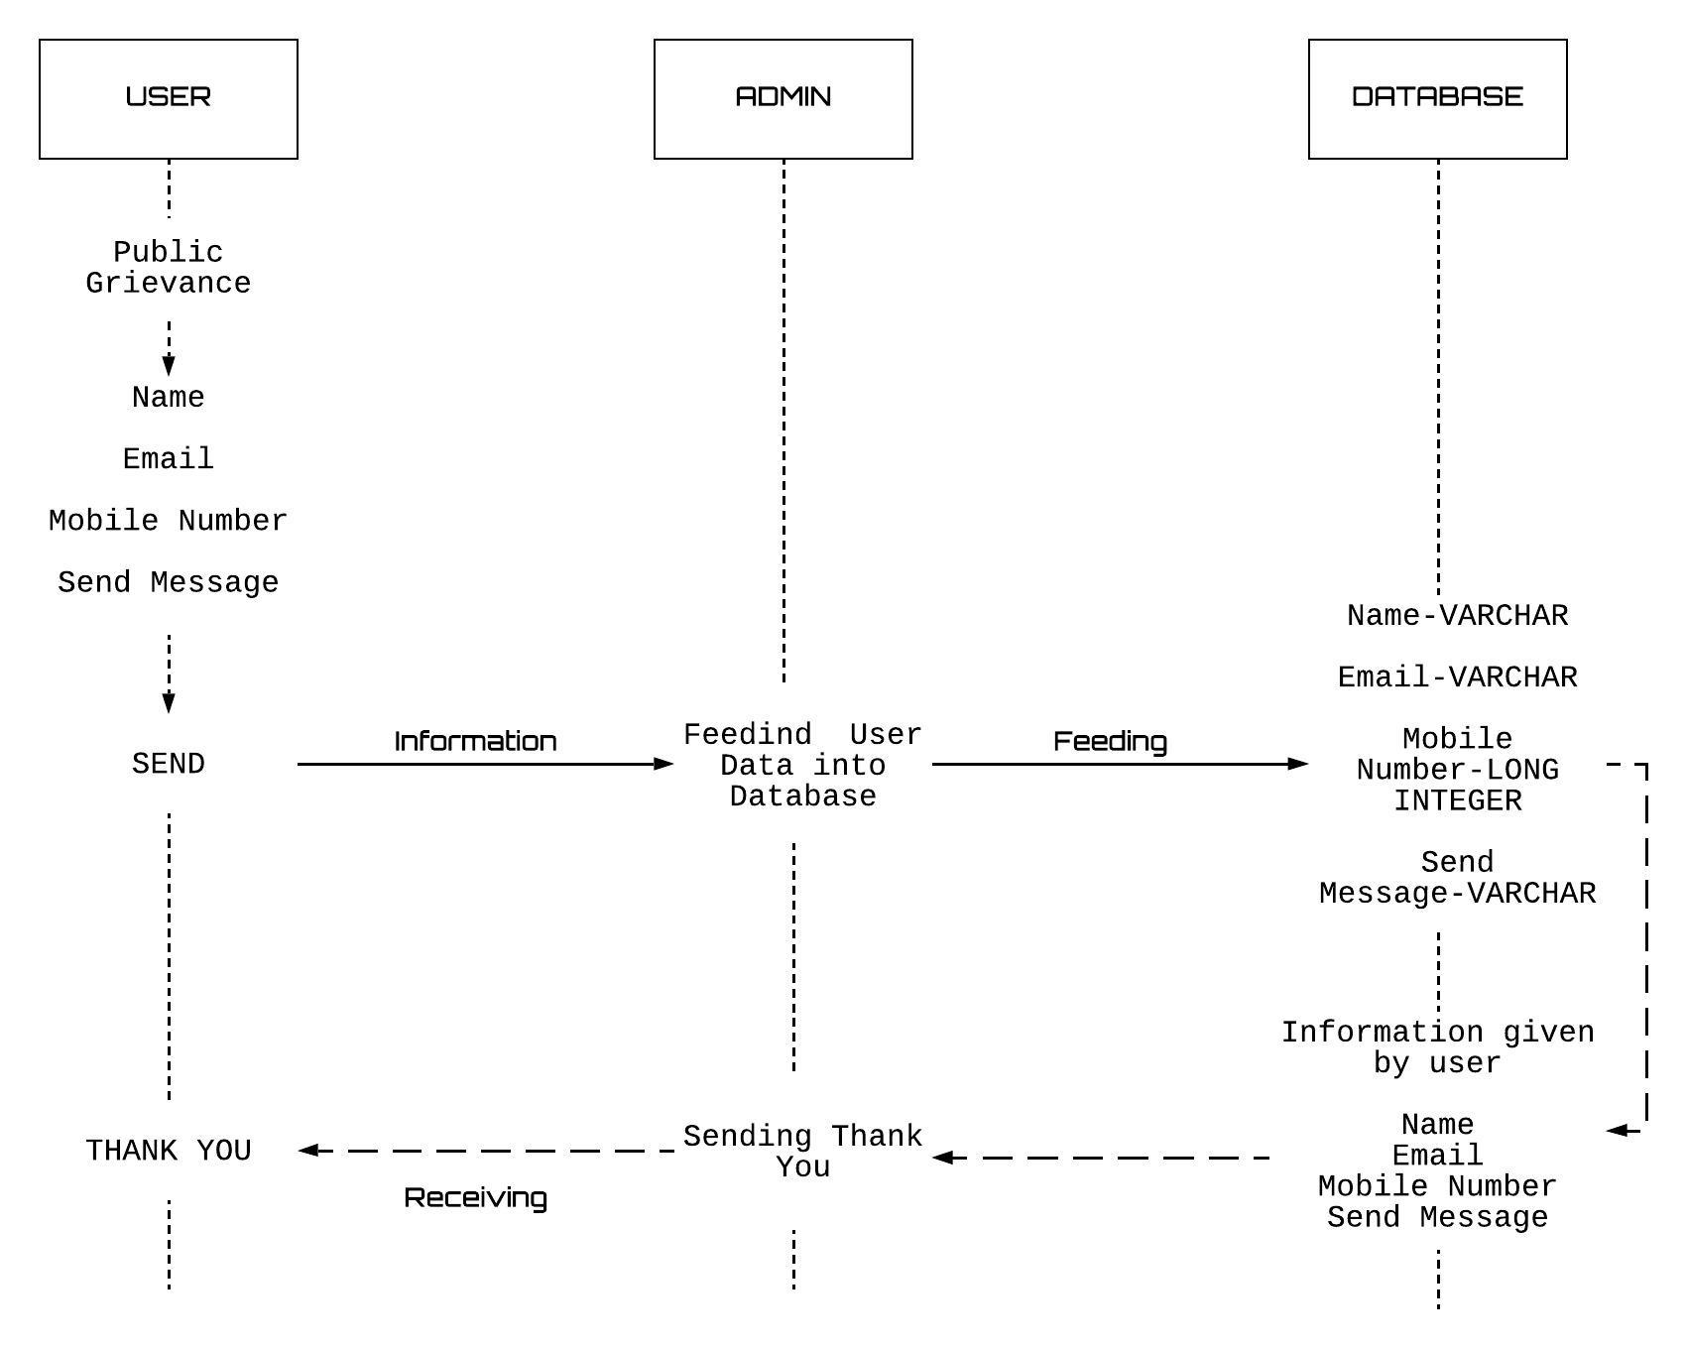

Slide 35
